Slide 1

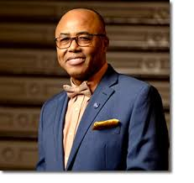
District 28 CEC Presentation
Superintendent: Dr. Eric L. Blake
Date: Thursday, January 8, 2026

Slide 2

Welcome Back!
Happy New Year and welcome back, District 28 community!
We are excited to begin 2026 together, continuing our shared
commitment to excellence and innovation for every student.
Let’s make this year one of growth, collaboration, and success.

Slide 3
District 28 Mission and Vision
Mission:
In Community School District 28 we focus on equity as a lever for achievement for every single scholar. We are a district of excellence. We commit to every school maintaining high academic standards and working closely with families so that all scholars are learning at high levels. Beginning with school leaders, teachers, students and community partners, we also commit to being a district of learners ensuring that we promote critical thinking rooted in core content conceptual understanding through creative problem solving, technology innovation, social emotional learning and community advocacy.
Vision:
In Community School District 28 we celebrate our differences because we understand that woven into those differences is the knowledge that they offer us unlimited possibility to learn and expand our knowledge of and commitment to all humanity. We are beautifully diverse, varied; coming from countless racial, ethnic, language, and belief backgrounds. We commit to striving for inestimable contribution to the lives of our scholars.

Slide 4
D28 Superintendent Priorities
Improve outcomes in Mathematics by implementing a common research-based curriculum and introducing or scaling, where appropriate, Regents level courses for scholars
01
Improve literacy skills by implementing research-based, Science of Reading (SOR) HMH curriculum in all K-8 schools.
02
Work to substantially improve daily attendance and reduce chronic absenteeism.
03
Continue to increase Parent and Family Engagement and Community Partnerships.
04

Slide 5
D28- District Non-Negotiables
Standards-Aligned Instruction: All lessons must be aligned to grade-level standards and learning objectives.
Small Group Instruction
Explicit Teaching with Gradual Release: Teachers model, guide, and then release responsibility for independent practice.
Active Student Engagement: Students are consistently engaged through questioning, discussion, and checks for understanding.
Data-Driven Differentiation: Instruction is adjusted based on formative assessment to meet diverse student needs within the core lesson.

Slide 6
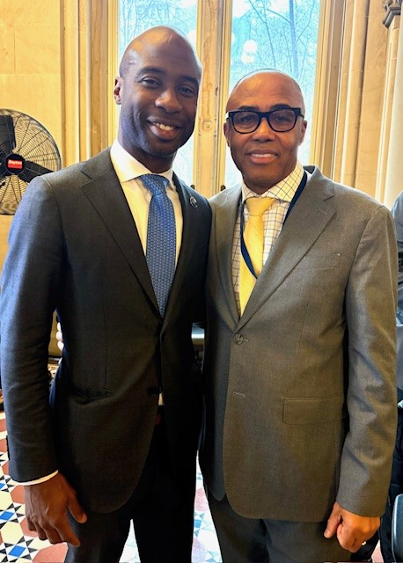
Congratulations, Chancellor Kamar Samuels!
We are thrilled to congratulate Chancellor Kamar Samuels on his appointment as New York City Schools Chancellor. As a district, we look forward to working closely with him to ensure every student receives the highest quality education and the support they need to thrive. Together, we will continue advancing equity, excellence, and opportunity across our schools. We also extend our heartfelt gratitude to outgoing Chancellor Melissa Aviles Ramos for her leadership and dedication. We wish her continued success and all the best in her future endeavors.

Slide 7
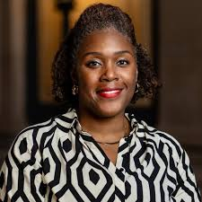
Congratulations, Dr. Hall
We extend our heartfelt gratitude to Deputy Superintendent Dr. Shonelle Hall for her outstanding
service and dedication to District 28. Her leadership, tireless hard work, and unwavering commitment
have made a lasting impact on our schools and community. Congratulations on your new role as Executive
Director at Tweed—we wish you continued success and look forward to seeing the great work you will accomplish.

Slide 8
Class Size
All schools have submitted their class size applications. District and Central officials review the applications, including exemption requests, in the following months (January-February).
Final offers for specific grades (like Kindergarten or 3-K) are released in the spring, once enrollment projections are clearer.

Slide 9
PS 160- Teacher Center
Congratulations to PS 160 on the opening of their new UFT Teacher Center! This exciting addition will provide valuable support and resources to educators, strengthening teaching and learning for all students. A big thank you to Principal Hicks and the UFT for their collaborative efforts in making this vision a reality.

Slide 10
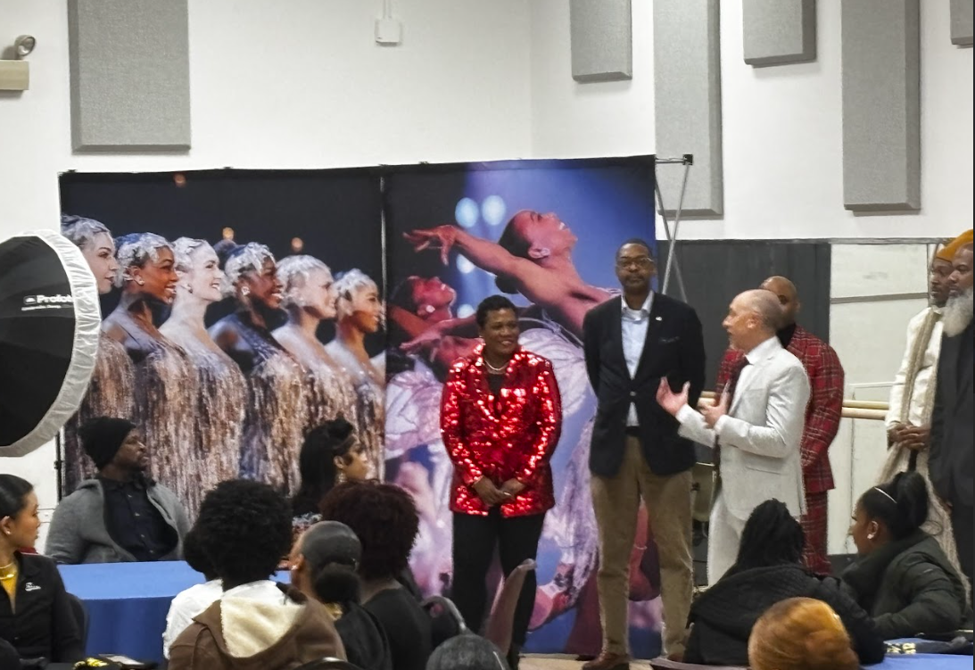
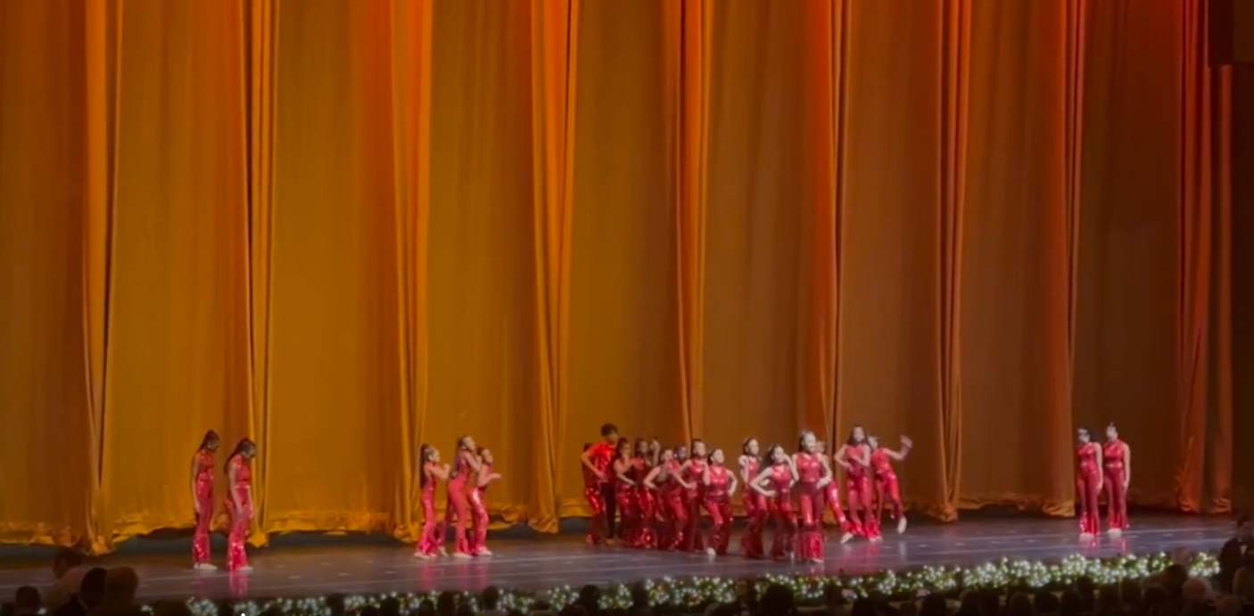
WAY TO GO! MS 72!
The Catherine and Count Basie Middle School (Q072) dance team was the first middle school to perform at a show with the Radio City Rockettes
-Dance students performed on the last day of the Rockettes’ 100th anniversary
-The students performed to an audience of 6,000
-After the student performance, parents, students, and staff enjoyed the Radio City Christmas Spectacular Holiday Show, a backstage tour, a visit by the dancers, pizza, and photos

Slide 11
Summer Rising
We have begun the process of finalizing schools for Summer Rising sites and affiliations. More information will be forthcoming as these are confirmed.

